Slide 1
Xbox Audio
Xfest
August 23, 2000
Brian Schmidt
Program Manager

Slide 2
Agenda
Xbox Audio Hardware Architecture
Xbox Audio Software
  DirectX 8.0 Audio Highlights
Summary

Slide 3
Xbox Audio Hardware Architecture

Slide 4
Xbox Audio Processor
Four independent hardware processors:
  Setup engine (DMA engine)
  Hardware mixing engine — fixed-function DSP for voice support
  Fully-programmable DSP for effects and other processing
  Dedicated DSP for multi-speaker surround encoding
You can create as many as 256 2-D/WT voices, all DLS-2+ capable
  Up to 64 can be 3-D HRTF voices
  DSP effects processing
  Any number of voices may be submixed before 3-D and/or effects are applied, maximizing hardware resources
Hardware EQ, filtering, envelope, LFOs, submixing on each voice
I3DL2-compliant 3-D positional effects
  Occlusion/obstruction, reverb… for all 3-D voices
You can use both the unified memory architecture and hard disk for fast access to huge amounts of audio data

Slide 5
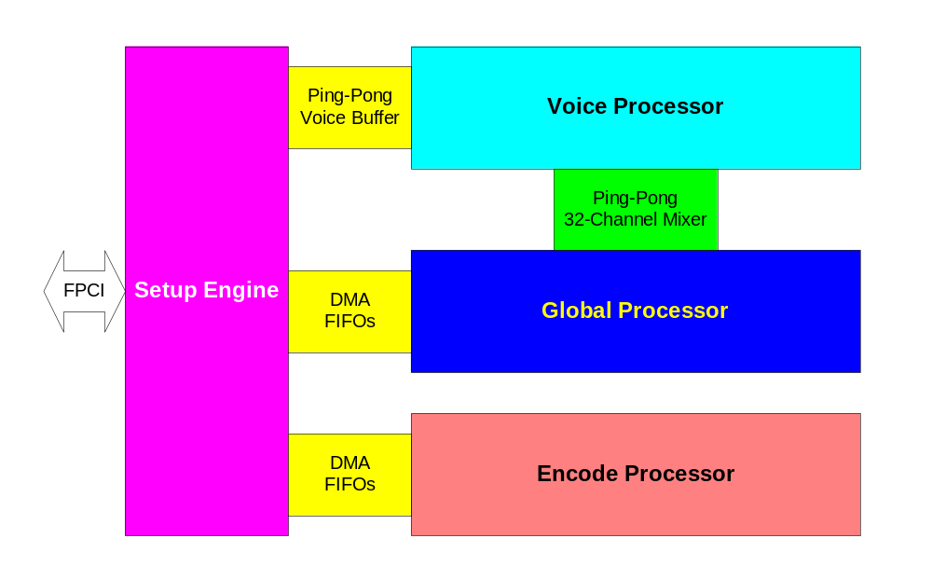
Audio Processing Unit (APU) Overview

Slide 6
Setup Processor
Interface between main Pentium CPU and other APU processors
DMA
Data formatting and packing
Parameter ramping
Other housekeeping duties

Slide 7
Voice Processor
Hardwired processor for PCM sound synthesis
256-voice pipeline
Submixing and effects sends
DLS-2+ filtering
Parametric EQ
64-voice 3-D HRTF, occlusion/obstruction filtering
5.1 panning
LFO, DAHDSR envelope

Slide 8
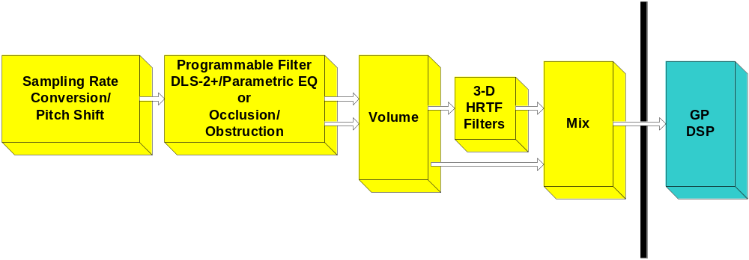
Voice Processor Pipeline

Slide 9
Global Processor
Semi-programmable DSP
Provides audio effects processing
Dedicated program and data RAM
DMA to main system memory
Receives data from Voice Processor
Sends data to Encode Processor

Slide 10
Encode Processor
Dedicated to real-time multi-speaker surround encoding
Sounds played with 3-D audio control will play out of 5.1 speakers
  3-D Audiopaths or DirectSound 3-D buffers
Music can be panned around 5.1 speakers

Slide 11
Audio Compression
Still under investigation
Codec libraries will support highly optimized IMA ADPCM and WMA decompression on the Pentium III CPU
Other x86 compression algorithms may be added
DSP hardware assist for some algorithms

Slide 12
Xbox Audio Software

Slide 13
DirectX 8.0 Audio Highlights
DLS-2 synthesis
Environmental 3-D reverberation
Audiopath APIs
Effects processing
Digital audio streaming and synchronization
Scripting

Slide 14
Design Goals for Xbox Audio Software
Supply the APIs that a game developer would need
  Thin layer APIs
    Code-driven audio
  Advanced-featured APIs
    Data sequencing, streaming, parsing, etc.
  Abstracted APIs
    Data/content driven audio
Mix and match APIs as needed

Slide 15
Xbox Audio Software Layers
DirectSound
  Lowest level access to audio hardware
DirectMusic
  Higher level
  Advanced sound effects
  Interactive music and MIDI
  Less code to write
  Partially data-driven
DirectMusic Scripting
  Completely abstracted from programmer
  Implementation details handled by audio designer/team
  Fully data-driven

Slide 16
DirectSound on Xbox
DirectSound
  Lowest level API exposed
  Sits “right on top” of chip registers
  Significantly extended from Windows version
    Provides access to custom features of hardware
    Provides enhanced streaming and decompression interfaces
  Many Windows methods removed
  No software mixing
    All mixing done on hardware

Slide 17
Capabilities of Xbox DirectSound
Hardware, 48-kHz mixing
Up to 256 hardware voices
64 3-D voices with hardware HRTF
  Multi-speaker HRTF with hardware I3DL2 environmental reverberation
Programmable hardware filters per voice
DSP effects processing
DAHDSR envelope
LFO

Slide 18
Advantages of Using DirectSound
Hardware is at the disposal of the programmer
Can do virtually anything the chip is physically capable of doing

Slide 19
DirectMusic on Xbox
Higher-level API
Signal processing still right on top of hardware
  Low overhead
Significantly simplified from Windows version
  Non-game APIs removed

Slide 20
Important!
Don’t be misled by the word “Music” in DirectMusic. DirectMusic is a set of audio APIs that know:
  Audio signals (sound)
  Musical information
  Advanced synthesis
DirectX 8.0 DirectMusic APIs have been created specifically with sound effects in mind

Slide 21
Capabilities of Xbox DirectMusic
256-voice DLS-2+ hardware synthesis
Interactive music with variability
Hardware Parametric EQ per voice
Submixing
Multi-channel output
Automated streaming
Automated SW decompression
Effects processing

Slide 22
Using DirectMusic
Sound designer creates content using DirectMusic Producer authoring tool
Segment files (.SGT) are delivered to programmer
Segments contain audio data in various formats
  Wave, MIDI, streaming, sequenced, one-shot, compressed…
Programmer plays the .SGT as they would a .WAV, etc., using DirectMusic APIs

Slide 23
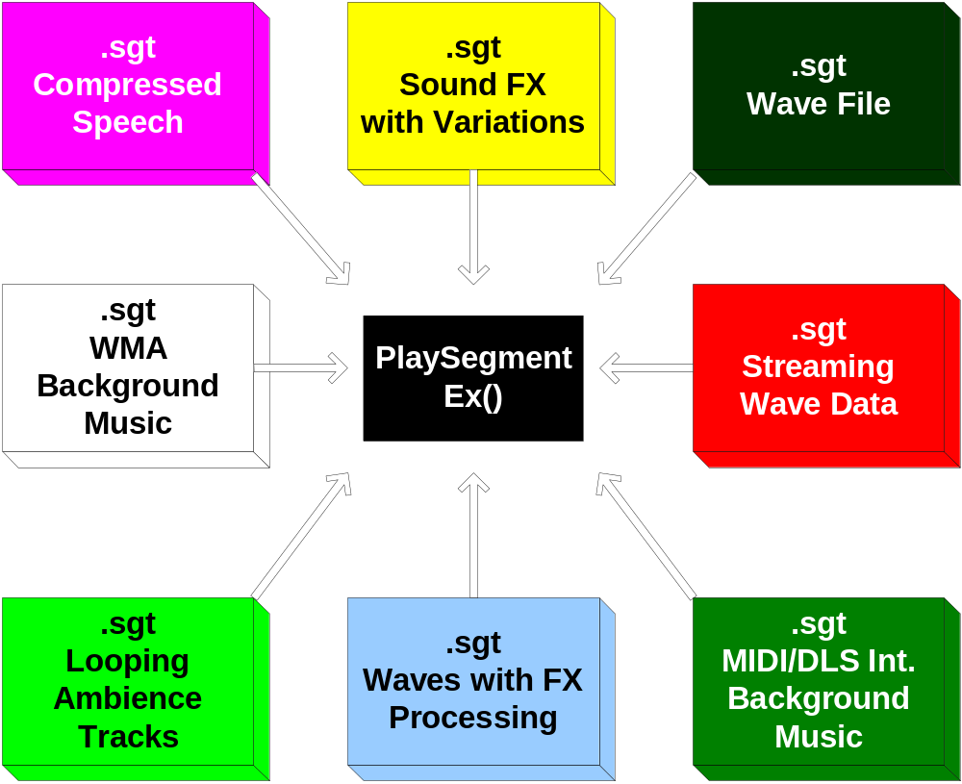
Playing Segments

Slide 24
Advantages of Using DirectMusic Segments
Audio designer can tweak sounds without requiring programmer intervention
  Volume, pitch, fx, etc.
Audio designer can change implementation without requiring programmer intervention
  Simple wave file -> sequenced score
  DLS music -> WMA file
Audio designer can use DirectMusic variability features
  Variations automatically played without additional work by programmer

Slide 25
DirectMusic Scripting on Xbox
Highly abstracted “C” API for game programmer
  Trigger-based API
  Only 8 methods on a single interface
Implementation handled by content via AudioVBScript language
  Proper subset of VBScript
  Streamlined and optimized for audio tasks
Scripts are embedded within the audio content itself

Slide 26
Advantages of Using Scripting
Programmer is (generally) freed from purely aesthetic audio decisions
Music and sound effects can change automatically in response to gameplay variables
Can streamline edit/integrate/listen cycle
Allows sound designer freedom to create more interactive soundtracks without relying on the programmer

Slide 27
DirectSound/DirectMusic/Scripting
Use DirectSound…
  When programmer desires complete low-level control
  For code-driven audio
Use DirectMusic…
  For interactive music, variability, streaming
  When more control is given to the sound designer
  For content-driven audio
Use DirectMusic scripting…
  For leaving implementation details to sound team
  For completely content-driven audio
  For self-modifying music

Slide 28
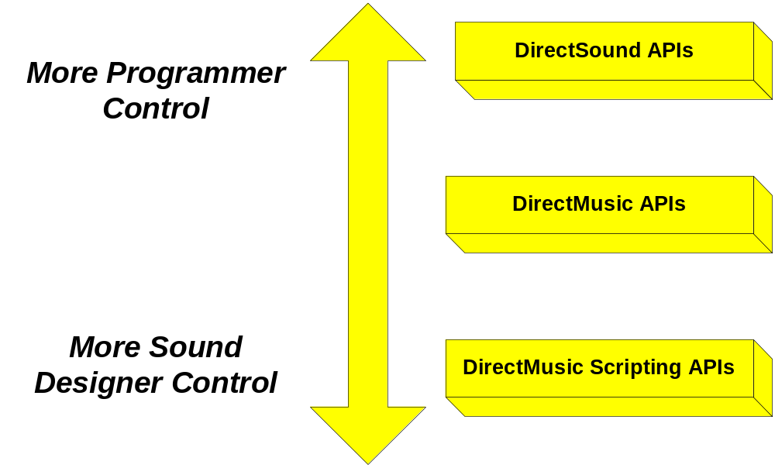
Software Levels of Control

Slide 29
Comparison of Audio Interfaces and Methods: Xbox Versus the PC
Greatly trimmed the audio APIs for Xbox
On the PC:
  DirectMusic - Interfaces: 27; Methods: ~226
  DirectSound - Interfaces: 20; Methods: ~103
On the Xbox game system:
  DirectMusic - Interfaces: 9; Methods: ~57
    Still many methods for advanced users
  DirectSound - Interfaces: 8; Methods: ~42
We still need to add the IDirectSoundStream APIs and register-level APIs

Slide 30
What Can’t You Do on Xbox?
We stripped away any methods dealing with Tools, audio-effects processing using x86 DirectX Media Objects (DMOs), and many extensibility APIs
  Currently, you would not be able to write Tools, DMOs, or custom Track types
  We will consider this later on
At this time, we will not bring the DirectMusic Software Synthesizer to Xbox
  This would give us support for alternate synthesis technologies (physical modeling synths, analog synths, FM synths, etc.) and support for software DMO plug-ins
  We will consider this later on

Slide 31
Audio Software Layers Recap
Xbox provides
  Very low-level APIs (DirectSound)
  Higher-level APIs (DirectMusic)
  Completely abstracted APIs (scripting)
Can mix and match APIs
Allows for control and implementation where you want it

Slide 32
Audio Software Summary
Plenty of horsepower to perform complex scores in real time using real-time effects
DirectSound can provide low-level access to hardware
DirectMusic tools and techniques enable interactive, variable music
  Also supports digital audio (WMA, wave) and MIDI+DLS
Audio scripting puts power into the hands of the content creator
  Audio designer and composer create scripts
  No longer necessary to recompile application
Allows for synchronization of pre-recorded audio and DirectMusic content

Slide 33
Summary
Please use the feedback form to give us feedback on what you’ve heard!
This talk was given by:
  Brian Schmidt, Xbox Audio
Questions?

Slide 34
Additional Slides
DX8 Interfaces and Features

Slide 35
DirectMusic Interfaces
IDirectMusicAudioPath8
IDirectMusicBand8
IDirectMusicLoader8
IDirectMusicObject8
IDirectMusicPerformance8
IDirectMusicSegment8
IDirectMusicSegmentState8
IDirectMusicScript8
IDirectMusicSong8

Slide 36
DirectSound Interfaces
IDirectSound8
IDirectSound3DBuffer8
IDirectSound3DListener8
IDirectSoundBuffer8
IDirectSoundNotify8
IDirectSoundFXSend8
IDirectSoundFXI3DL2Reverb8
IDirectSoundFXI3DL2Source8
Function
  DirectSoundCreate8

Slide 37
DLS-2 Synthesis
DLS-2: advancement over DLS-1
Resonant filter per voice
128 regions for all DLS instruments
Layering of voices
6-segment DAHDSR envelope
2 LFOs
Xbox voice features beyond DLS-2
  Additional filter modes
  Parametric EQ per voice

Slide 38
Environmental Reverberation Modeling
Provides simple, preset-based but flexible environmental reverb modeling for DirectSound3D
I3DL2-compliant reverberation and occlusion/obstruction
Multi-speaker reverberation

Slide 39
DirectMusic Audiopaths
Object used to play back sounds
  Like a “buffer on steroids”
Can play all audio content
  Sound effects, music, voice…
Allows control from note generation through DLS-2 processing, and of any effects down to the final output
  Includes any effects-processing information, 3-D, synthesizer channels, etc.
Multiple sounds can be played on a single Audiopath

Slide 40
Effects Processing
Hardware Parametric EQ possible on every voice
DSP effects
  Reverb, chorus, flange, distortion, echo
Hardware occlusion/obstruction processing on every 3-D voice

Slide 41
Wave Playback Track
Used to coordinate playback of pre-recorded music (WMA, streaming, etc.)
  Cross-fading, synchronized start, timed transitions…
Provides method for playing back wave files or streaming files from disk
  Allows synchronization of MIDI and digital audio playback
  Can be used for pure synchronized digital audio playback
Supports compressed data formats
Notes:
h

Slide 42
Audio Scripting
Allows composers and sound designers greater power and flexibility in game audio design, improving audio development process
  Very simple scripting language
  Extremely simple “C” API for programmer
Less work required by programmer for advanced audio implementations
More interactive sound effects and music

